Slide 1
2 Following a conversation
Listening skills

Slide 2
Following a conversation
In this unit you will practise:
identifying the speakers
matching items
identifying function
completing notes
understanding categories
completing a table

Slide 3
Following a conversation-Identifying the speakers
1 Identifying the speakers
For Sections 1 and 3 each speaker will have a different voice to help you tell them apart (e.g. male / female; younger /older). Both speakers will talk equally, and you will hear answers from both speakers.
For Section 1 there is normally one person who has to fine out information from the other.

Slide 4
Following a conversation-Identifying the speakers
1.1 You will hear three short extracts from Listening Section 1. Listen and identify what makes each speaker different, and what information they want to find out.

Slide 5
Following a conversation-Identifying the speakers
8
 | people | description | Information wanted
1 | Travel agent | Older female | The customer would like information about …
 | customer
2 | hotel receptionist |  | The receptionist needs to find out the guest’s
 | guest
3 | interviewer |  | The applicant would like to know about…
 | job applicant
younger male
(good offers on) skiing trips.
younger female
older male
personal details
older female
younger male
travel and working hours
Study Tip

Slide 6
Following a conversation-Identifying the speakers
Study Tip
You will hear native speaker accents from several English-speaking countries in the test. These may include British, American, Canadian, Australian and New Zealand accents. Search online for non-commercial national radio stations in these countries, and try to listen to a variety of them. National stations often have talk or current affairs programmes that can help you practise for IELTS.

Slide 7
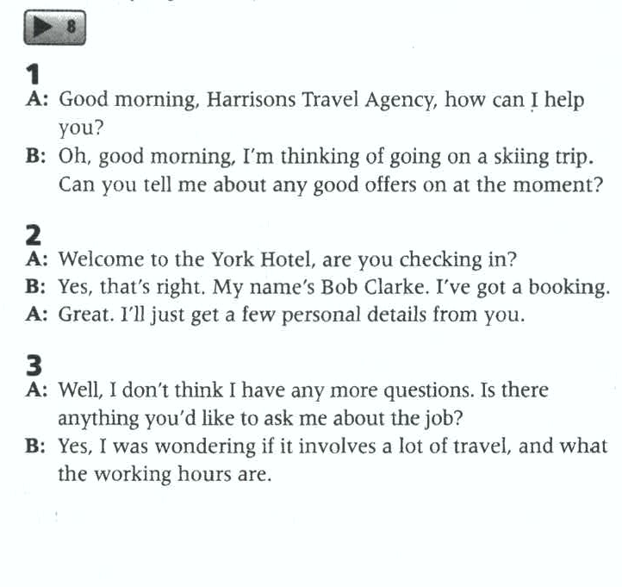
8

Slide 8
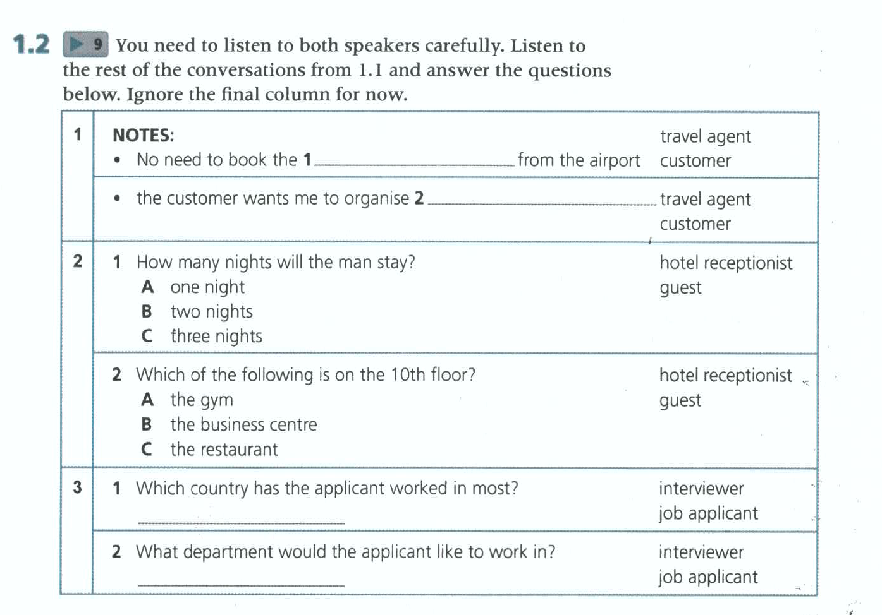
9
Circle the person who provided the answer. Sometimes both are possible.
coach
insurance
both
America
marketing

Slide 9
9-1
Listen again for details
Things discussed | details
fares
skiing slopes
friends
coach
taxi
lift
equipments
insurance
￡150 including airfare
Self arrange, 2 hours trip
Meet
Tickets arranged usually
expensive
better
Self prepared
yes

Slide 10
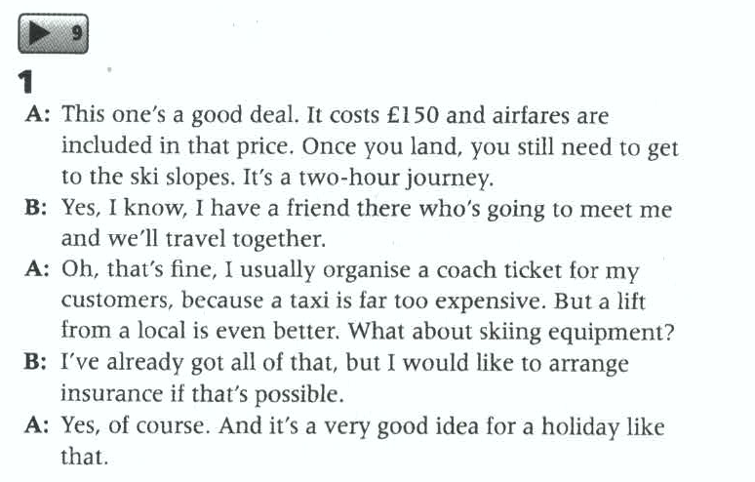
9-1

Slide 11
What kinds of service can the man get access to?
9-2
Extra night: no need to change room
25% discount
Access to business center on the 10th floor (the same as his room)
Access to gym or sport center on the 9th floor

Slide 12
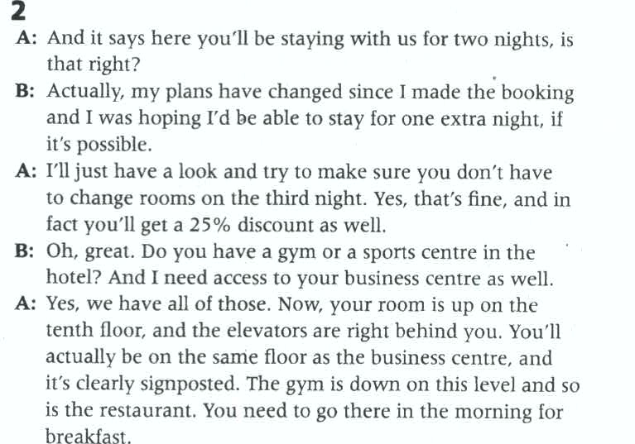
9-2

Slide 13
9-3
1
Countries | Did what
England
Australia
America
born
Emigrated when young
Longest employment (5yrs), graduate
2. What are her working experiences?
3. In what field does she hope to work?
Accounts, sales
marketing

Slide 14
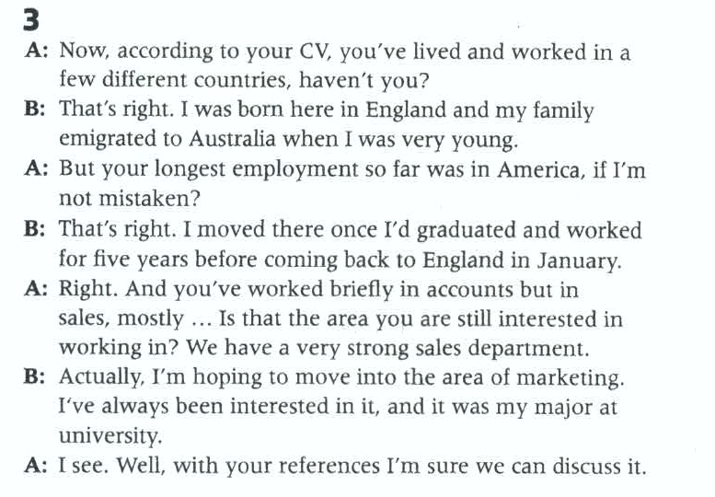
9-3

Slide 15
Following a conversation-Identifying function
2 Identifying function
Each speaker has a specific purpose in mind when they talk. We say their language has a function. We use different language for different functions.

Slide 16
Following a conversation-Identifying function
10
2 .1 Listen to seven short extracts from different conversations. Complete extracts 1-7.
1 ____________ getting her a new bike?
2 ___________ . We arrive on 22nd July.
3 That sounds great. _____________.
4 _____________ I’d enjoy that one.
5 You said you’d prefer to have the party outside, _____________
6 _________, it’s just gone up to $250.
7 ______, _____________ accommodation? Where would you like to stay?
What about
That’s right
Let’s do that
I don’t think
is that right?
Actually
Now
what about

Slide 17
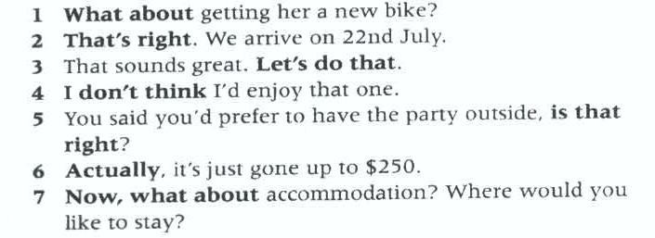
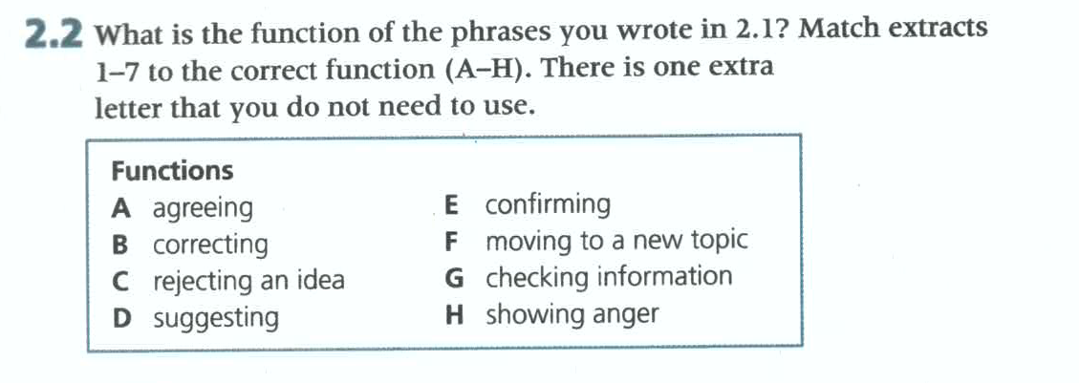
3
2
6
7
4
5
1

Slide 18
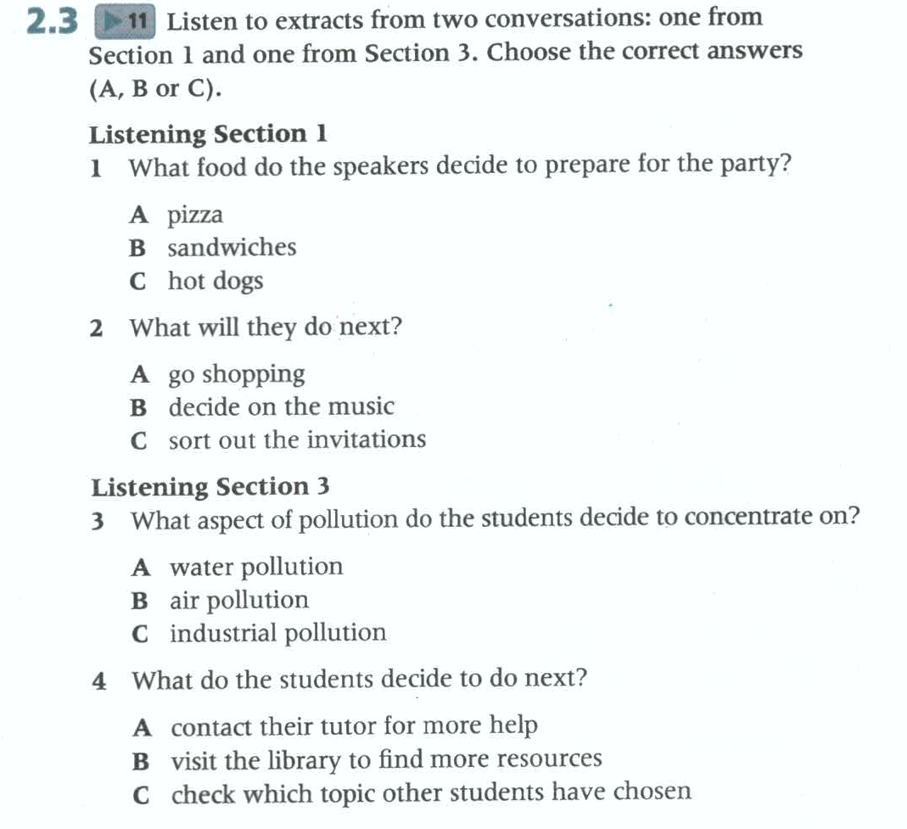
Following a conversation-Identifying function
11

Slide 19
11-1
Small topics | choices | reasons
Small topics | choices | reasons
 | Pizza
 | Barbecue/hot dogs
 | Sandwich
food
Always, expensive
Too much preparation
Even more preparation
Invitation
DIY on computers
Keep cost down
music
Old stuff from last year
fine

Slide 20
11-2
Choose a tipic
Look for resources
Ask classmates
What are the things they need to do?
Their topic should be base on the theme of _______?
One of them prefer the topic of ______?
What did they choose finally?
Where are they going to look for resources?
Why do they need to ask classmates?
pollution
Water pollution
Effects of fumes on air quality
online
Make sure not to do the same thing

Slide 21
Following a conversation-Identifying function
11
2.4 Look at the phrases below. Listen again and decide whether the phrases are in Extract 1 or Extract 2
a That's a good idea.
b Actually, I think we're better off looking online.
c Why don't we ... ?
d We could look at ...
e What about a ... ?
f Let's ask them.
g Pizzas it is, then!
1
2
1
2
1
2
1

Slide 22
Following a conversation-Identifying function
2
h Shall we go to ... ?
i You're right ...
j That's right.
k So we could just do that?
I We'd better not.
m We'd better start ...
n Now, we also need to ...
o So, what else do we need to do?
p But we always do that.
2
2
2
2
1
1
2
1

Slide 23
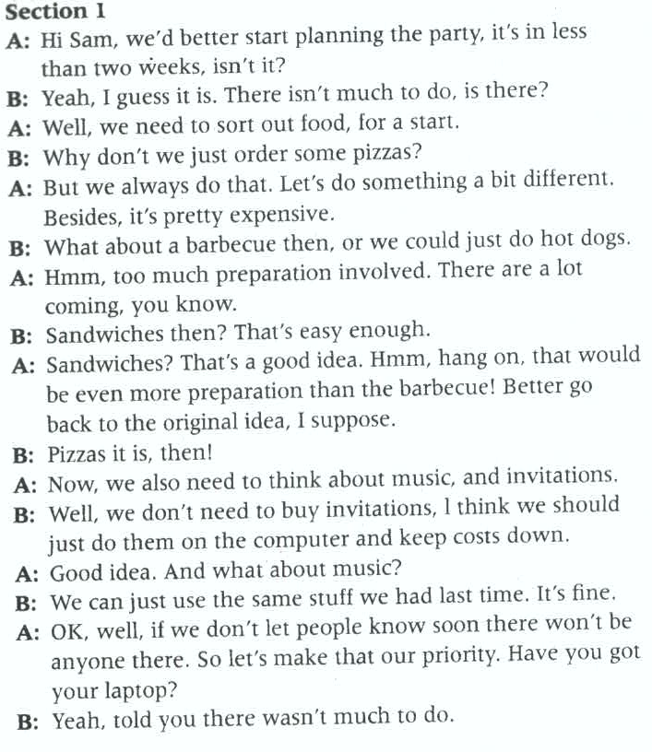
11-1

Slide 24
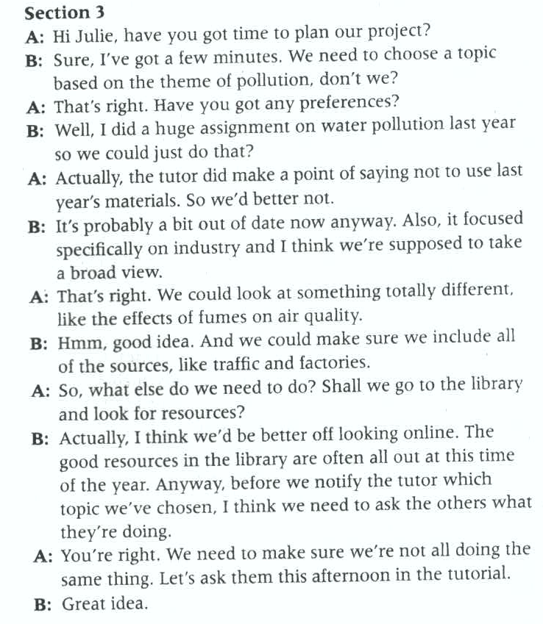
11-2

Slide 25
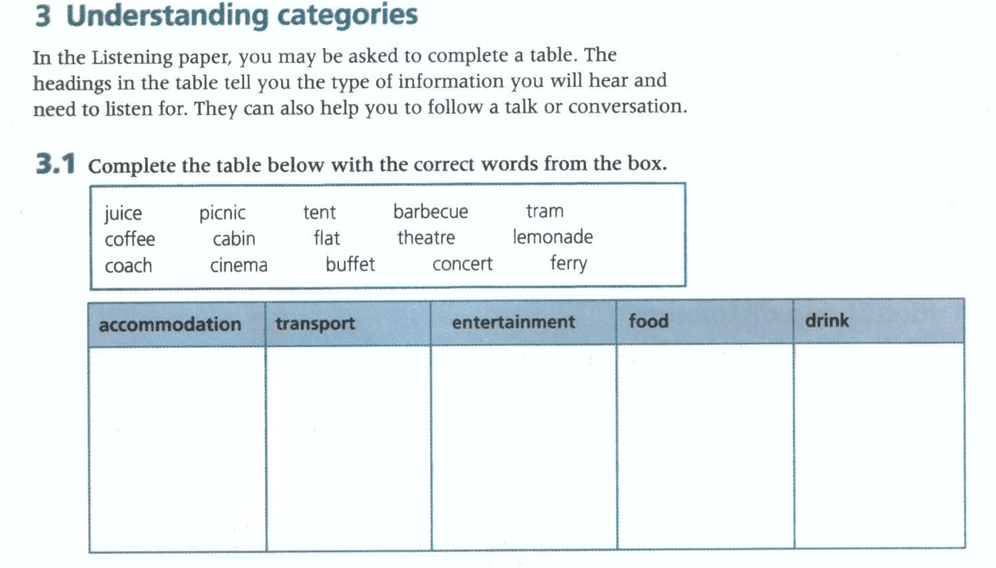
tent
tram
theatre
picnic
cabin
ferry
cinema
barbecue
lemonade
coach
buffet
coffee
flat
concert

Slide 26
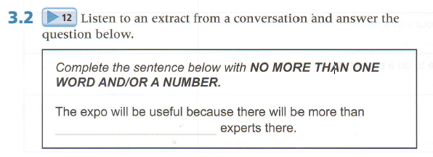
12
250 computer
two hundred and fifty computer

Slide 27
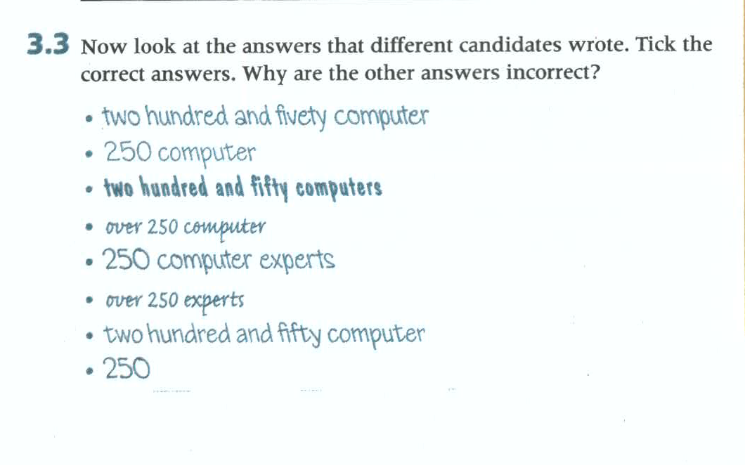

Slide 28
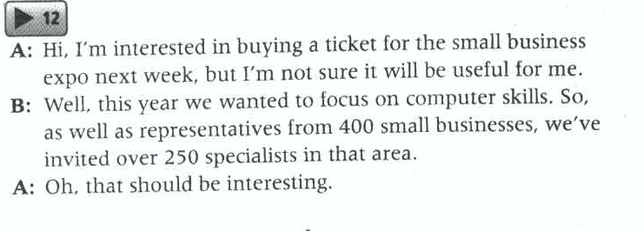
12

Slide 29
innovation
revival
strategic
following the pack
talent
harness
consent
potential
cliché
constantly
align
campaign
trickle down

Slide 30
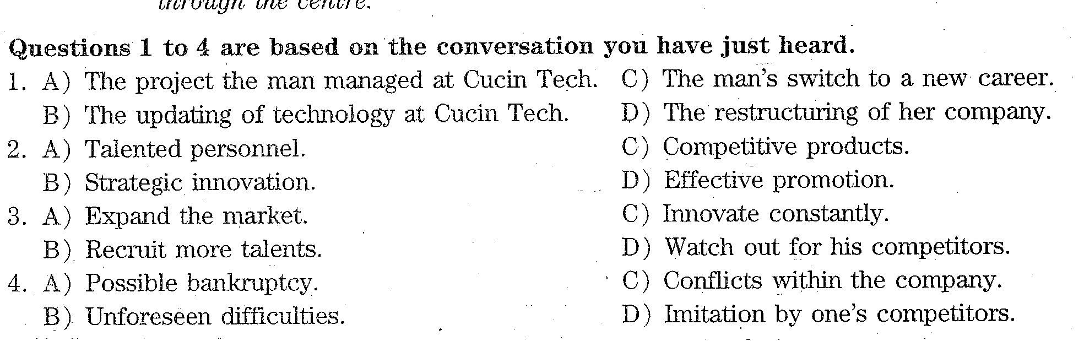
2016.06第二套对话1

Slide 31
